Slide 1
GPGPU introduction

Slide 2
Why is GPU in the picture
Seeking exa-scale computing platform
Minimize power per operation.
Power is directly correlated to the area in the processing chips.
Regular CPU – what are the chip areas going into?
Power per operation is low
How to maximize power per operation?
Give most area to build lots of ALUs, minimize area for control and cache.
This is how GPU is built → power per operation is much better than regular CPU
Most power efficient system built using CPU only, IBM Bluegene reaches 2Gflops/Watt
System built using CPU+GPU can reach close to 4Gflops/Watt.

Slide 3
Graphics Processing Unit (GPU)
GPU is the chip in computer video cards, PS3, Xbox, etc
Designed to realize the 3D graphics pipeline
Application → Geometry → Rasterizer→ image
GPU development:
Fixed graphics hardware
Programmable vertex/pixel shaders
GPGPU
general purpose computation (beyond graphics) using GPU in applications other than 3D graphics
GPGPU can be treated as a co-processor for compute intensive tasks
With sufficient large bandwidth between CPU and GPU.

Slide 4
CPU and GPU
GPU is specialized for compute intensive, highly data parallel computation
More area is dedicated to processing
Good for high arithmetic intensity programs with a high ratio between arithmetic operations and memory operations.
Control
ALU
ALU
ALU
ALU
Cache
DRAM
DRAM
CPU
GPU

Slide 5
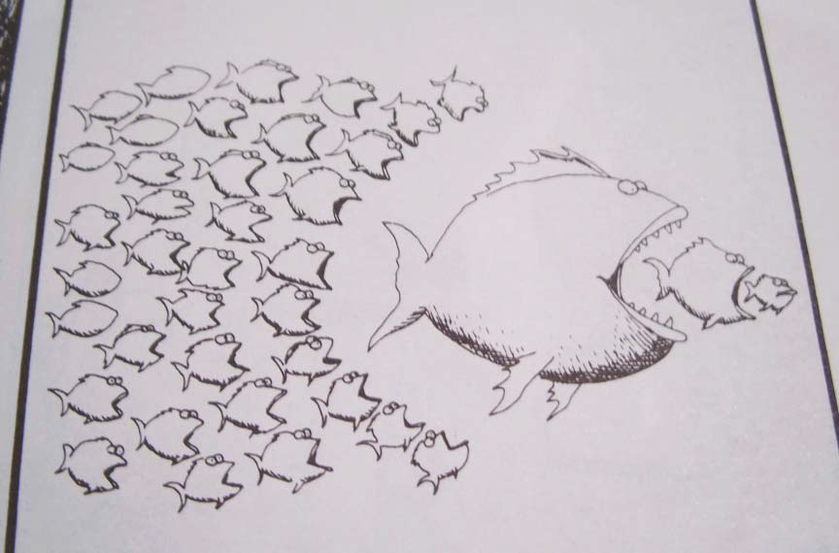
A powerful CPU or many less powerful CPUs?

Slide 6
Flop rate of CPU and GPU
Single Precision
Double Precision
GFlop/Sec

Slide 7
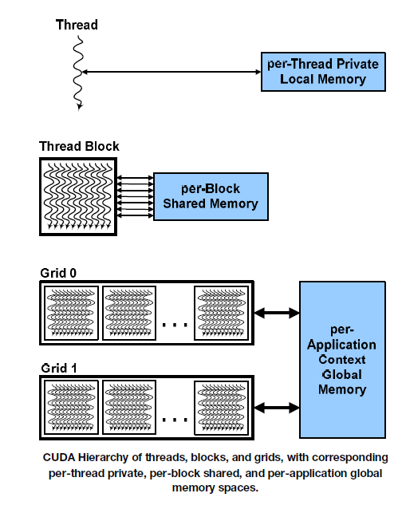
Compute Unified Device Architecture (CUDA)
Hardware/software architecture for NVIDIA GPU to execute programs with different languages
Main concept: hardware support for hierarchy of threads

Slide 8
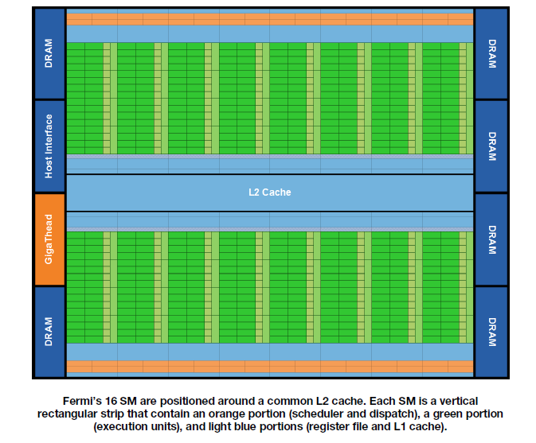
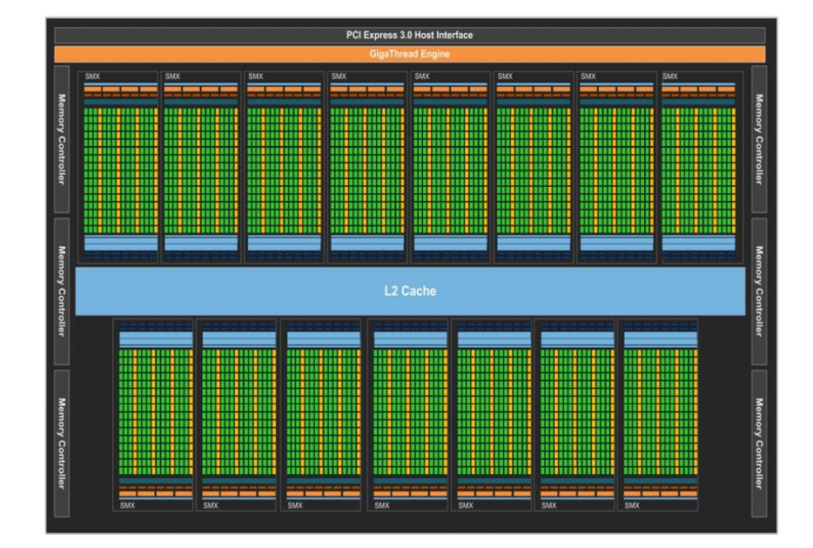
Fermi architecture
First generation (GTX 465, GTX 480, Telsa C2050, etc) has 512 CUDA cores
16 stream multiprocessor (SM) of 32 processing units (cores)
Each core execute one floating point or integer instruction per clock for a thread
Latest Tesla GPU: Tesla K40 have 2880 CUDA cores based on the Kepler architecture. Warp size is still the same, but more everything.
Kepler architecture: 15 SMX

Slide 9
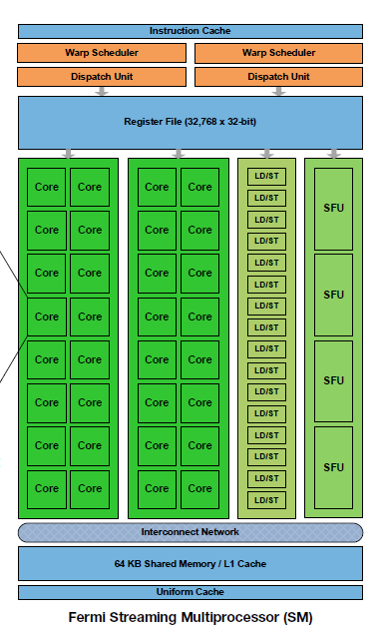
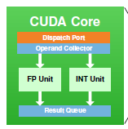
Fermi Streaming Multiprocessor (SM)
32 CUDA processors with pipelined ALU and FPU
Execute a group of 32 threads called warp.
Support IEEE 754-2008 (single and double precision floating points) with fused multiply-add (FMA) instruction).
Configurable shared memory and L1 cache

Slide 10
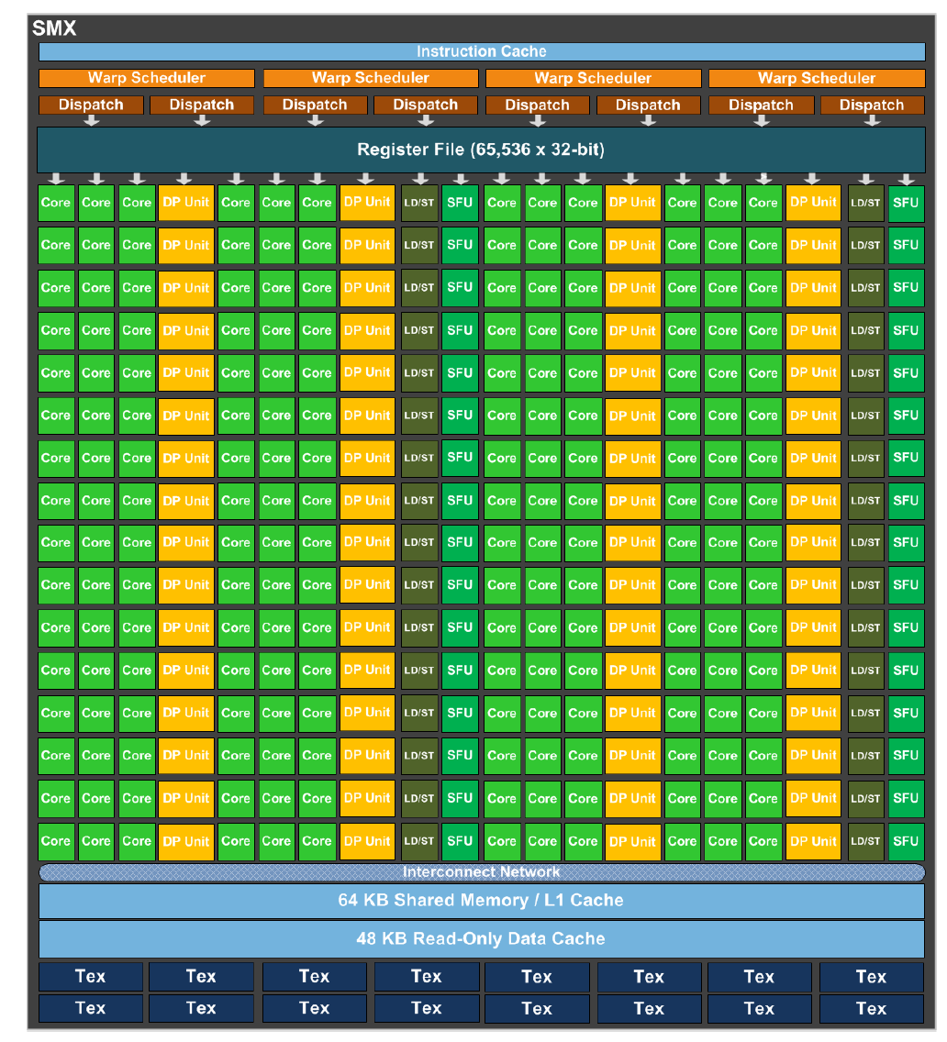
Kepler Streaming Multiprocessor (SMX)
192 CUDA processors with pipelined ALU and FPU
4 warp scheduler
Execute a group of 32 threads called warp.
Support IEEE 754-2008 (single and double precision floating points) with fused multiply-add (FMA) instruction).
Configurable shared memory and L1 cache
48K data cache

Slide 11
SIMT and warp scheduler
SIMT: Single instruction, multi-thread
Threads in groups (or 16, 32) that are scheduled together call warp.
All threads in a warp start at the same PC, but free to branch and execute independently.
A warp executes one common instruction at a time
To execute different instructions at different threads, the instructions are executed serially
To get efficiency, we want all instructions in a warp to be the same.
SIMT is basically SIMD that emulates MIMD (programmers don’t feel they are using SIMD).

Slide 12
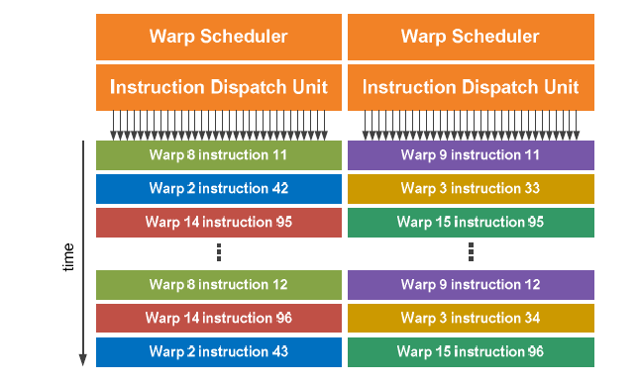
Fermi Warp scheduler
2 per SM: representing a compromise between cost and complexity

Slide 13
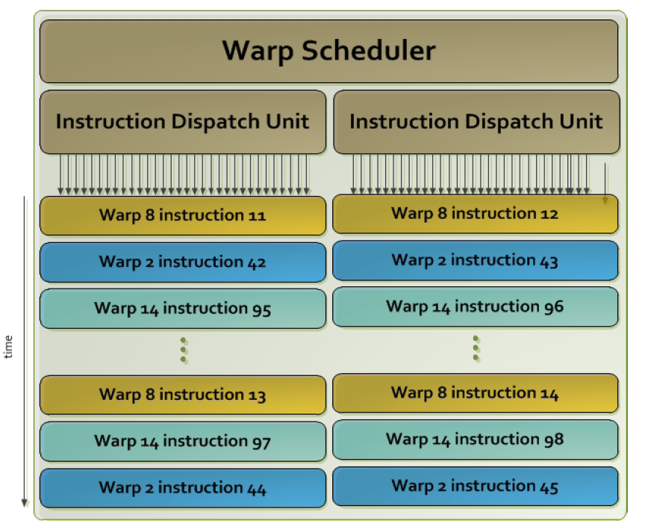
Kepler Warp scheduler
4 per SM with 2 instruction dispatcher units each.

Slide 14
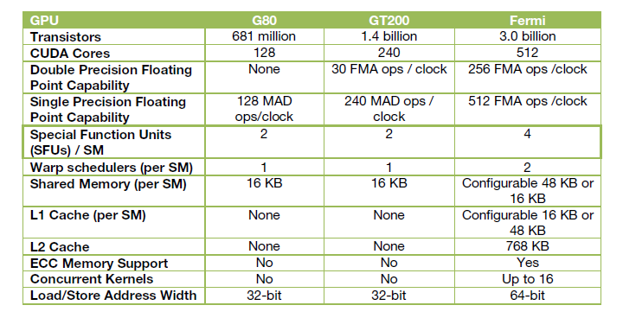
NVIDIA GPUs (toward general purpose computing)
Control
ALU
ALU
ALU
ALU
Cache
DRAM
DRAM

Slide 15
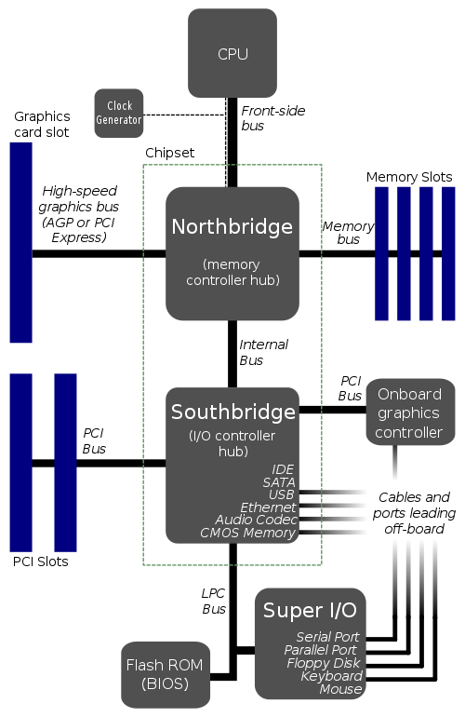
Typical CPU-GPU system
Main connection from GPU to
CPU/memory is the PCI-Express (PCIe)
PCIe1.1 supports up to 8GB/s (common systems support 4GB/s)
PCIe2.0 supports up to 16GB/s

Slide 16
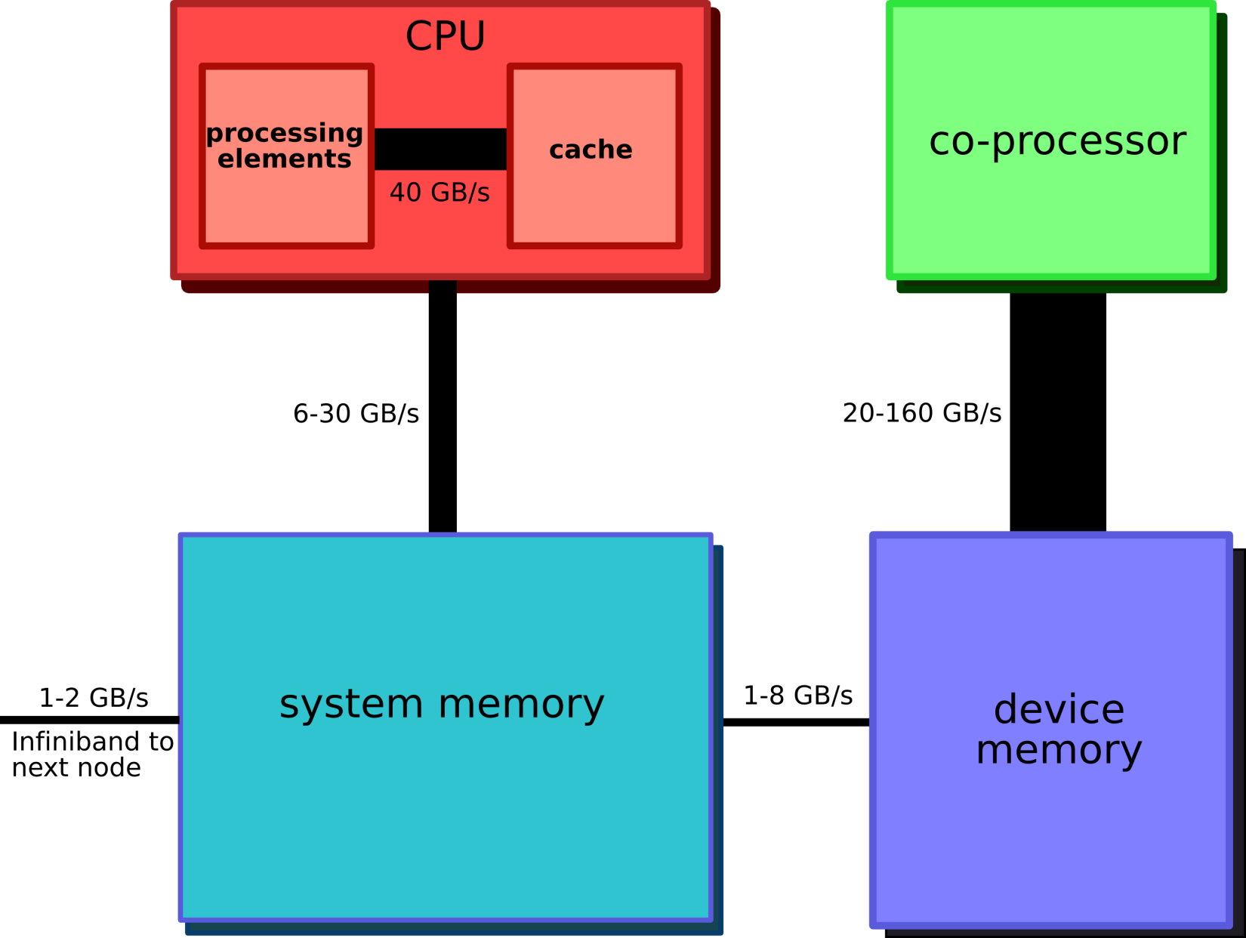
Bandwidth in a CPU-GPU system

Slide 17
GPU as a co-processor
CPU gives compute intensive jobs to GPU
CPU stays busy with the control of execution
Main bottleneck:
The connection between main memory and GPU memory
Data must be copied for the GPU to work on and the results must come back from GPU
PCIe is reasonably fast, but is often still the bottleneck.

Slide 18
GPGPU constraints
Dealing with programming models for GPU such as CUDA C or OpenCL
Dealing with limited capability and resources
Code is often platform dependent.
Problem of mapping computation on to a hardware that is designed for graphics.

